Slide 1
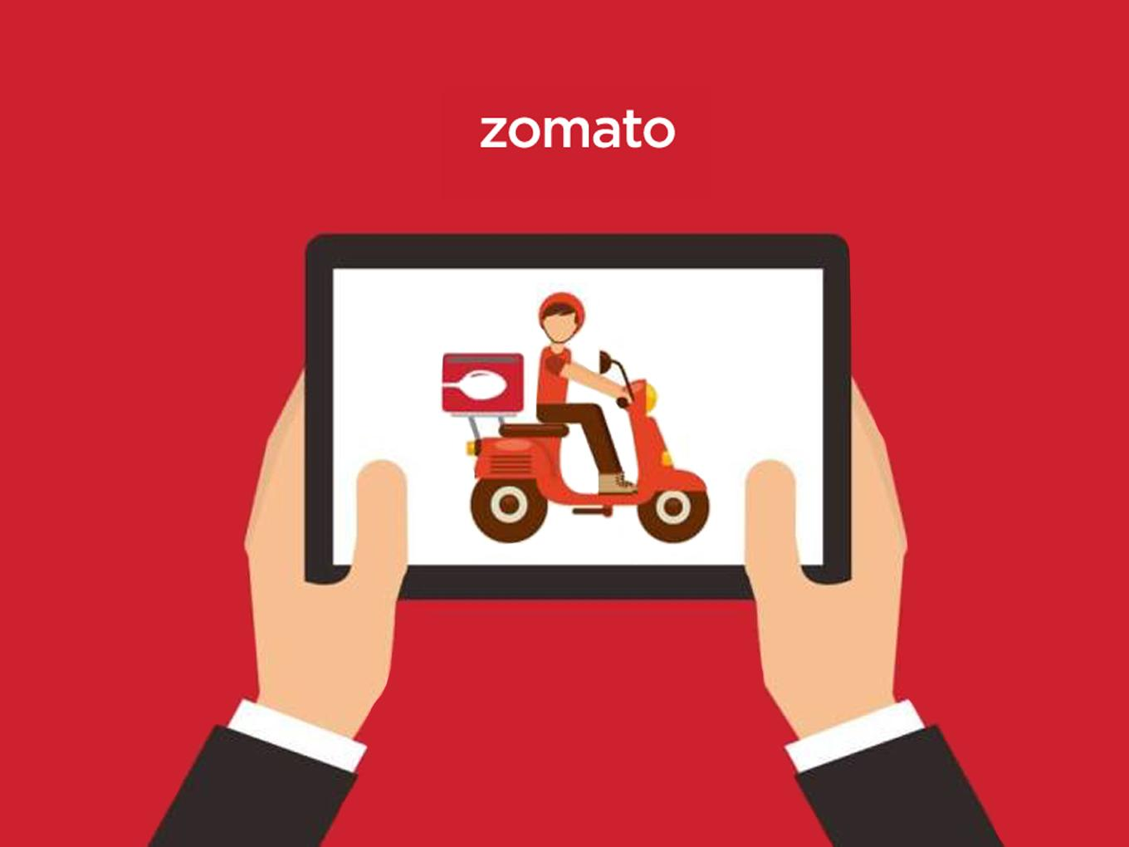
ZOMATO RESTAURANT ANALYSIS
Never have a bad meal
BY PAVITHRA M

Slide 2
INTRODUCTION
Zomato-an online food delivery platform was established in 2008 by Deepinder Goyal and Pankaj Chaddah.
The foodtech delivers over 1.5 millio n orders daily.
Zomato bagged the top honours at the seventh edition of The Economic Times Startup Awards in 2021.
The most significant hurdle in the Zomato journey is to find a way to cover all the restaurants in all the areas in all the pivotal cities.

Slide 3
ABOUT DATASET
The Zomato_data excel workbook consists two sheets.
Raw_Data(Sheet1)containing 9552 rows(including Headers) and 21 Columns giving detailed information about Restaurant names along with Location of the restaurant and Data of its opening.
Country_description(Sheet2) contains Country id and Country Name of all the countries in which the restaurants are available.
The main data sheet consists of the details such as price range, average cost for two people and the ratings given by its customers.

Slide 4
Country Vs No of Restaurants

Slide 5
The Following chart depicts the number of opening of restaurants happened in different Years and Months

Slide 6
Restaurants having services like Table Booking and Online Delivery along with their Ratings

Slide 7
The Rating of the restaurants is high for lower price ranges 1 and 2

Slide 8
The distribution of Price Range in different countries

Slide 9
The chart shows that the rating is not affected by the choice of Cuisine

Slide 10
SUGGESTED COUNTRIES
Canada
Qatar
Singapore
Sri Lanka
The above countries having lower restaurant count will have less competency and it also provide expansion into different states and cities in that countries.

Slide 11
The rating and average cost of two in the suggested countries also strongly supports the suggestions.

Slide 12
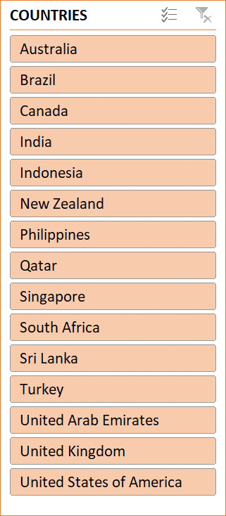
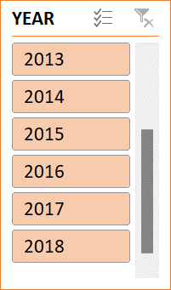
RESTAURANTS
9551
ZOMATO RESTAURANT ANALYSIS
COUNTRIES
15
VOTES
1498645
CITIES
376
LOCALITIES
1208
CUISINES
1825

Slide 13


